Slide 1
Education and Meetings
Educational Calendar
Online Education
Claim your CME & MOC
Exhibitor & Sponsorship Opportunities
Annual Meeting Widget
Education Exhibitor & Sponsors
Regional Courses Regional Course
Annual Meeting Annual Meeting & PG Course
Education Universe
SAT
SAP-MOC
Journal CME & MOC
CME Mission Statement
CME Conflicts of Interest Policy
This info should be on the bottom of ALL ACG pages

Slide 2




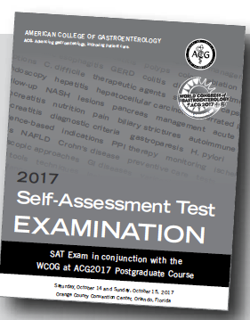


Educational Calendar (same page for online education)
Meetings
Online Education
Note- this list would include ALL programs and events (may say by invitation only or by application only)
ACG / LGS Regional Course
March 9-11
Hyatt French Quarter
New Orleans, LA
Click here to Register
ACG / FGS Regional Course
March 16-18
Hyatt Regency Coconut Point Resort & Spa
Bonita Springs, FL
Click here to Register
ACG’s IBD School &
Eastern Regional Course
Seaport Hotel
April 13-15
Boston, MA
Click here to Register
ACG’s Hepatology School &
Midwest Regional Course
Sheraton Indianapolis City Centre Hotel
August 24-26
Indianapolis, IN
Click here for More Information
ACG 2018 Annual Scientific Meeting
& Postgraduate Course
Pennsylvania Convention Center
October 5-10
Philadelphia, PA
Click here for More Information
SAP-MOC (need nice image)
Exhibitor Information (sticky)
Endorsed Courses (sticky)

Slide 3
Claim Your CME & MOC
Regional Meetings
Annual Meeting & Postgraduate Course
AJG – Journal
CME & MOC
Education Universe CME

Slide 4

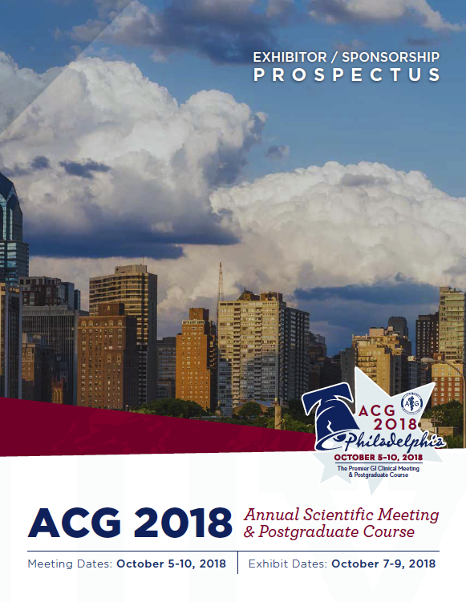
Sponsorship & Exhibitor Information
ACG’s 7 Regional Meetings
ACG 2018
Annual Scientific Meeting & Postgraduate Course

